Slide 1


RealTime Clock With Primum Features
David Iluz & Dor Agababa

Slide 2



Frameworks And Languages used in the project

Slide 3

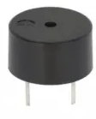
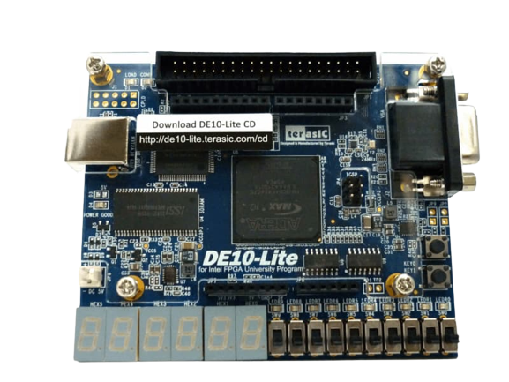
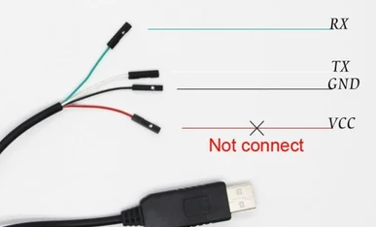
FPGA needed plugins
White USB
Green USB
GPIO
Red USB
Black USB
GND for alarm
Data For Alarm

Slide 4
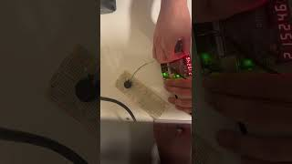
Introduction

Slide 5
Setup
Plug in the FPGA to the pc. Plug in the UART connection. Plug in the Buzzer.
Run the NodeJS Script (../intelChal/getDataToFolder.js).
Open Quartus and run TCL script, compile and program the FPGA.
Run the Python Script (../FPGATime/main.py).
*note: inside the python script you might need to configure the UART-COM according to your pc,NodeJS script Ethernet connection.
In the new version: there is generic bat file that run all. Just click it.

Slide 6


User Manual
BtnUp
SEL[2]
SW[6]
SW[5]
SEL[1]
SW[4]
SEL[0]
BtnDown
SW[7]
SW[0] / ENABLE
SW[1] / RESET
SW[3] / LOADS
Buttons Mapping

Slide 7
Available Modes
Modes are selected using the SEL switches(leds indicate the mode) Mapping for modes using SEL (by the order SEL2,Sel1,Sel0)
MODE Name | SEL2 | SEL1 | SEL0
RealTime clock | 0 | 0 | 0
Timer | 0 | 0 | 1
Stopper | 0 | 1 | 0
DDT Mode (Rotated Text) | 0 | 1 | 1
Set FPGA owner Name | 1 | 0 | 0
Set Alarm clock | 1 | 0 | 1
Editable Clock | 1 | 1 | 0
Mute alarm | 1 | 1 | 1

Slide 8
RealTime Clock Mode
This mode Shows the current time in Israel.
This mode uses the following:
UART – making connection between the PC and the FPGA through USB cable. After programming the FPGA we need to run the python script in order to transfer the current time to the FPGA.
The FPGA is waiting for the first time to get data from the USB, after the data will transfer, the clock will start to show the time and it cannot be edited again or stopped.
SEL[2]
SEL[1]
SEL[0]

Slide 9
Timer Mode
BtnUp
In this mode you can set timer to specific time. How to use:
LOADS needs to be up in order to edit the timer. you can edit hour minutes and seconds using the Edit Switches and BtnUp to increase the number and BtnDown to decrease. After you finish Drop LOADS to 0 And PullUp ENABLE Switch. RESET switch will set the timer to 0.
BtnDown
Edit MM
LOADS
ENABLE
SEL[2]
Edit SS
RESET
SEL[1]
SEL[0]
Edit HH

Slide 10
Stopper Mode
BtnUp
In this mode you have a stopper. How to use: Switch Enable needs to be Up in order to use the stopper. Double click the BtnUp will start the time from 0 and another double click will stop the time, and so on. You can reset the mode by pulling up and down the reset switch.
RESET
ENABLE

Slide 11
DDT Mode – Date Dollar Temperature
In this mode you have a Current Date, Dollar Rate and temp according to TLV. The data is fetched using two interfaces, NodeJS and TCL script. How to use: Switch Enable need to be Up in order to Rotate the data.
While the enable is down, the data will stand still, and you will see only the date.
ENABLE

Slide 12
Set Owner Name Mode
BtnUp
BtnDown
In this mode you can set the name of the FPGA owner. How to use: Every SW switch controls the letter that will appear in the 7 segment display. To change the letter the switch needs to be up and the control is by the Up and Down Buttons.
SW[7]
SW[1]
SW[6]
SW[5]
SW[4]
SEL[2]
SW[3]
SEL[1]
SEL[0]

Slide 13
Alarm clock Mode
BtnUp
BtnDown
In this mode you can set Alarm clock to a specific time. When the time that you set equals to the real time clock, the buzzer will ring. How to set the alarm:
LOADS needs to be up in order to edit the alarm, you can edit hour minutes and seconds using the Edit Switches and BtnUp to increase the number and BtnDown to decrease. After you finish editing Drop LOADS to 0. RESET will reset the numbers on the 7 segments to 0.
Edit MM
LOADS
SEL[2]
Edit SS
RESET
SEL[1]
SEL[0]
Edit HH

Slide 14
Editable clock
BtnUp
BtnDown
In this mode you can set a clock to specific start time. How to use:
LOADS needs to be up in order to edit the timer, ENABLE should be down. you can edit hour minutes and seconds using the Edit Switches and BtnUp to increase the number and BtnDown to decrease. After you finish Move LOADS switch down And Pull Up ENABLE Switch in order to start working. RESET switch will set the timer to 0. Note: the clock wont work when RESET is up.
Edit MM
LOADS
ENABLE
SEL[2]
Edit SS
RESET
SEL[1]
SEL[0]
Edit HH

Slide 15
Mute Alarm Clock
In this mode, you will mute the alarm clock. When the alarm start ringing the way to mute it is by getting into this mode.
Note: this mode has no other functionality.
SEL[2]
SEL[1]
SEL[0]

Slide 16
Thank You For Listening

